Slide 1
NYC Flag Competition
Here are some paintings you can use as inspiration to create your flag Good luck!

Slide 2
Famous NYC Landmarks

Slide 14
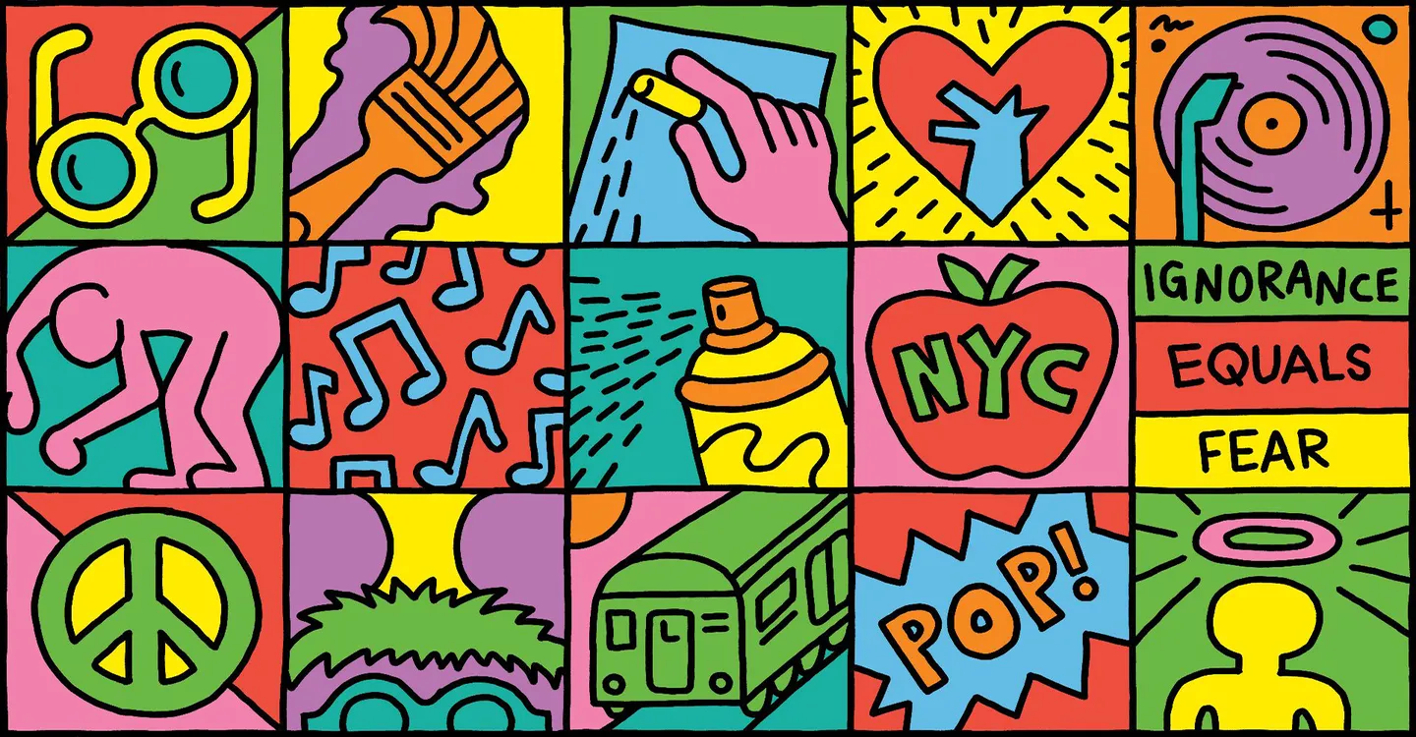
Now here are some artist’s you can use as inspiration for your flag
…

Slide 15
Georgia O'keeffe

Slide 20
KarenTarlton

Slide 21
Keith Haring

Slide 24
Banksy Street Art
There is always hope

Slide 27
These are all just examples for inspiration, you are not obligated to use them. Also if you want to emulate another artist that would be fantastic. Good luck!!

