Slide 1
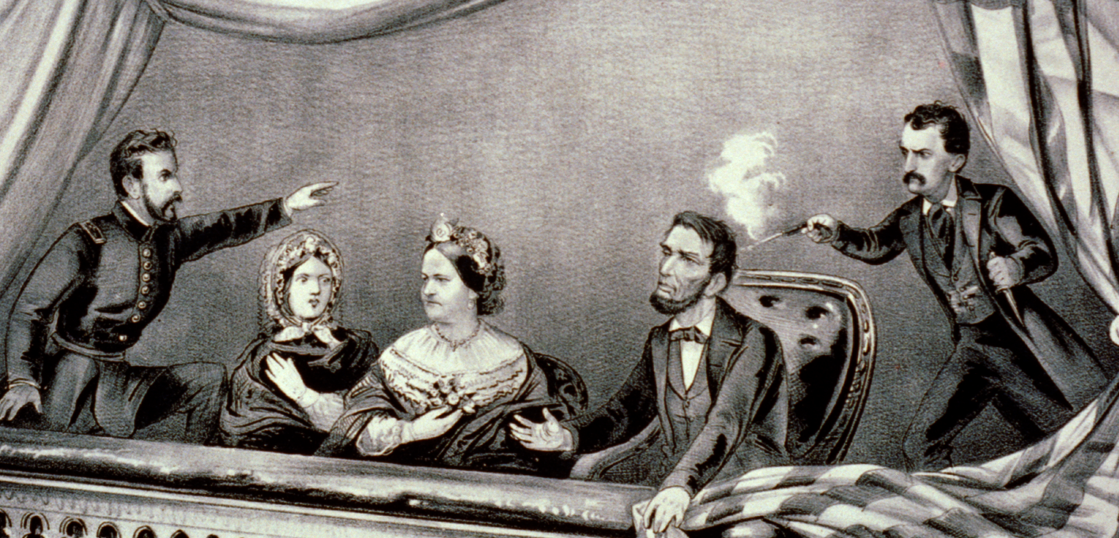

Slide 2
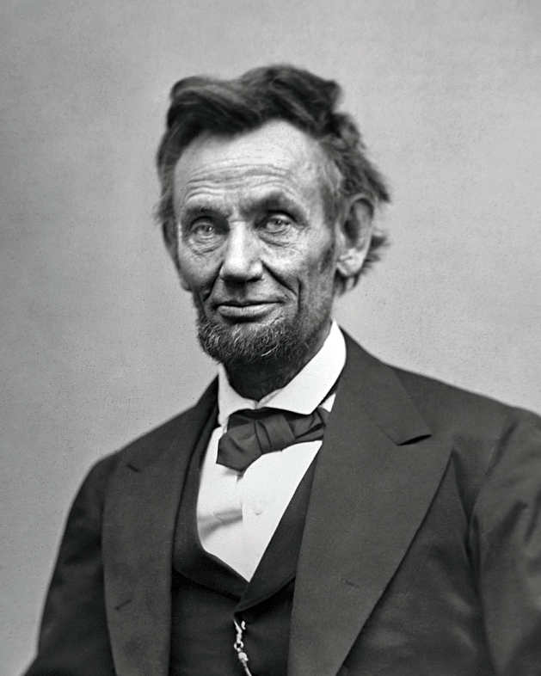
ASSASSINATION OF ABRAHAM LINCOLN
Born on February 12th, 1809 in Kentucky, Abraham Lincoln would be the 16th President of the United States when he was first elected in 1861.

Slide 3
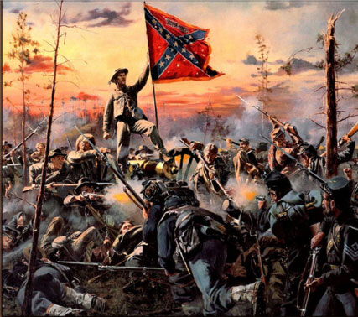
ASSASSINATION OF ABRAHAM LINCOLN
Abraham Lincoln would be the President of the United States from 1861 until April 14th, 1865 when he was assassinated.
During his presidency he oversaw a difficult time in American history – the Civil War.

Slide 4
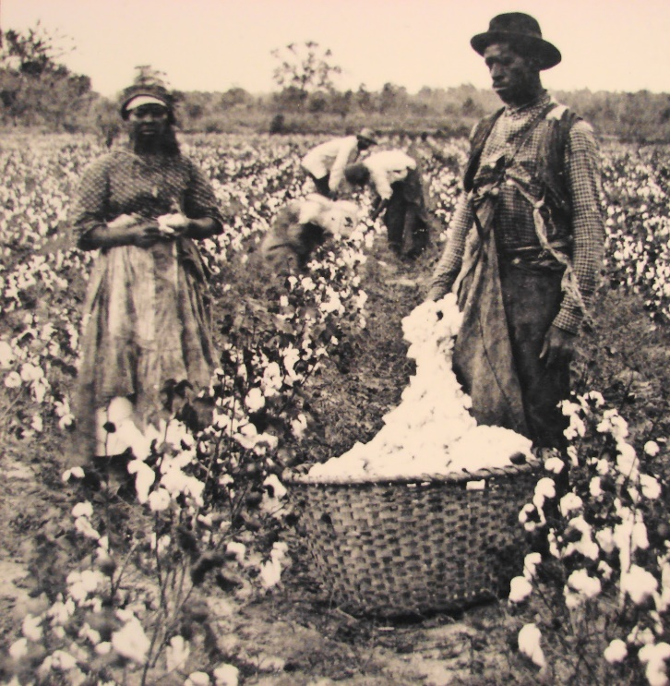
ASSASSINATION OF ABRAHAM LINCOLN
The Civil War would deeply divide the United States between the North and South over issues of: the role of government and the issues surrounding slavery.

Slide 5
ASSASSINATION OF ABRAHAM LINCOLN
By the time it ended in Confederate surrender in 1865, the Civil War proved to be the costliest war ever fought on American soil, with some 620,000 of 2.4 million soldiers killed.
The Civil War and Lincoln’s role in it would be a significant factor in his assassination.

Slide 6
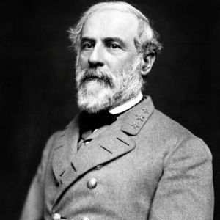
ASSASSINATION OF ABRAHAM LINCOLN
Abraham Lincoln was assassinated on April 14th, 1865, only five days after Confederate General Robert E. Lee surrendered his army at Appomattox Court House, Virginia, effectively ending the American Civil War.

Slide 7
ASSASSINATION OF ABRAHAM LINCOLN
On April 14th, 1865 John Wilkes Booth (an actor and Confederate sympathizer) shot and killed Abraham Lincoln at Ford’s Theatre in Washington D.C.

Slide 8
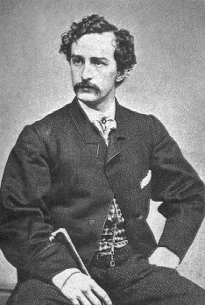
ASSASSINATION OF ABRAHAM LINCOLN
John Wilkes Booth was born in 1838 in Maryland and worked as an actor in the North despite his support for the Confederacy during the Civil War.

Slide 9
ASSASSINATION OF ABRAHAM LINCOLN
Booth had made earlier attempts to save the Confederacy and carry out an attack against Lincoln.
Near the end of the Civil War John Wilkes Booth had actually been part of a plot to kidnap Lincoln and take him to Richmond the Confederate capital.
The day of the planned kidnapping, Lincoln failed to appear and the plan failed. Two weeks later, Richmond fell to Union forces.

Slide 10
ASSASSINATION OF ABRAHAM LINCOLN
After his first planned failed, Booth planned another attack against Lincoln, for the 14th of April.
Booth and his conspirators planned to assassinate Lincoln.

Slide 11
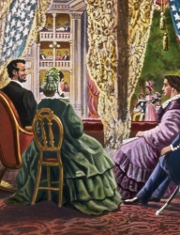
ASSASSINATION OF ABRAHAM LINCOLN
Booth learned that Lincoln was the attend a showing of “Our American Cousin” at Ford’s Theatre on April 14th and planned his attack.
Lincoln attended the show with his wife Mary, a young army officer named Henry Rathbone and Rathbone’s fiancé in a private box above the stage.

Slide 12
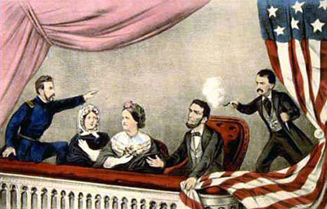
ASSASSINATION OF ABRAHAM LINCOLN
During the show Booth went to Lincoln’s private box and fired his .44-caliber single-shot derringer into the back of Lincoln’s head.

Slide 13
ASSASSINATION OF ABRAHAM LINCOLN
Next Booth stabbed Rathbone, and then leapt onto the stage and shouted, “Sic semper tyrannis!” which means “Thus ever to tyrants!” which is the Virginia state motto.
He then fled and was able to escape Washington D.C. on horseback.

Slide 14
ASSASSINATION OF ABRAHAM LINCOLN
Charles Leale (a doctor) was in the audience and immediately went to Lincoln’s private box upon hearing the shot fired.
He found the president slumped in his chair, paralyzed and struggling to breathe.
Several soldiers carried Lincoln to a house across the street and placed him on a bed.
When the surgeon general arrived at the house, he concluded that Lincoln could not be saved and would die during the night.

Slide 15
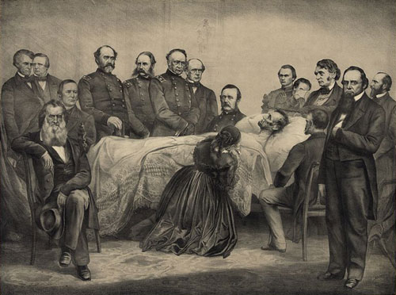
ASSASSINATION OF ABRAHAM LINCOLN
Vice President Andrew Johnson, members of Lincoln’s cabinet and several of the president’s closest friends stood vigil by Lincoln’s bedside until he was officially pronounced dead at 7:22 a.m.

Slide 16
ASSASSINATION OF ABRAHAM LINCOLN
The country quickly mourned the death of Lincoln.
Flags across the country flew at half-mast, and businesses were closed as people learned of the president’s death.

Slide 17
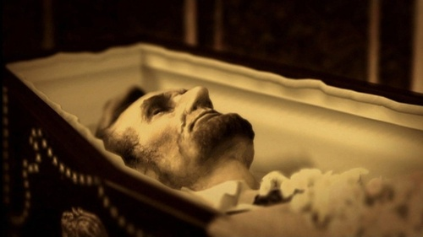
ASSASSINATION OF ABRAHAM LINCOLN
Lincoln’s body was taken to the White House, and on April 18 it was carried to the Capitol rotunda to lay in state.

Slide 18
ASSASSINATION OF ABRAHAM LINCOLN
On April 21, Lincoln’s body travelled by train to Springfield, Illinois, where he had lived before becoming president.
Tens of thousands of Americans lined the railroad route and paid their respects to their fallen leader during the train’s progression through the North.
Lincoln was interred on May 4, 1865, at Oak Ridge Cemetery, near Springfield.

Slide 19
ASSASSINATION OF ABRAHAM LINCOLN
As the nation mourned, Union soldiers were hot on the trail of John Wilkes Booth, who many in the audience had immediately recognized.
After fleeing Washington D.C., he and an accomplice, David Herold, made their way across the Anacostia River and headed toward southern Maryland.

Slide 20
ASSASSINATION OF ABRAHAM LINCOLN
On April 26, Union troops surrounded the Virginia farmhouse where Booth and Herold were hiding out.
The Union troops set fire to the farmhouse, hoping to flush the fugitives out.
Herold surrendered but Booth remained inside.
Booth was shot in the neck in the confrontation.

Slide 21
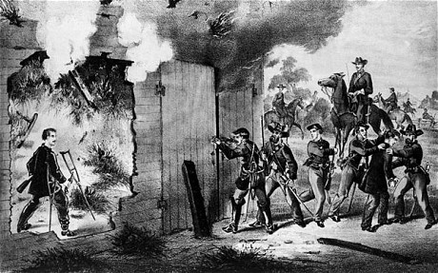
ASSASSINATION OF ABRAHAM LINCOLN
Carried out of the building alive, he stayed alive for another three hours before reportedly looking at his hands and uttering his last words: “Useless, useless.”

Slide 22
ASSASSINATION OF ABRAHAM LINCOLN
Four of Booth’s co-conspirators were convicted for their part in the assassination and executed by hanging on July 7, 1865.
They included David Herold and Mary Surratt, the first woman put to death by the federal government, whose boarding house had served as a meeting place for the would-be kidnappers.

